Slide 1
Comparative Study To Solve Academic Timetable Scheduling Problem
Salman Shah | 15IT241
Aiman Abdullah | 15IT106
Jyoti Prakash | 15IT213
Abhishek S | 15IT202

Slide 2
Aim
More about the objectives to be achieved during the course of the project.

Slide 3
Aim
The aim of the project is to do a comparative study between finding a solution to solve the Academic Timetable Scheduling Problem.
It also to aims find a way to use both Neural Networks and Genetic Algorithms to optimize the solution of the problem.

Slide 4
Introduction
A swift introduction to Genetic Algorithms and Neural Networks

Slide 5
Introduction - Genetic Algorithms
Definition:
Genetic Algorithms is a heuristic search method used in artificial intelligence and computing to find optimized solutions to search problems based on primiarily based on Charles Darwin’s Theory of Natural Selection and the principle of “Survival of the Fittest”.
Applications:
Genetic Algorithms are applied to a wide range of fields including robotics, automotive design, optimized telecommunications routing, engineering and computer-aided molecular design.

Slide 6
Introduction - Genetic Algorithms (Contd.)
Use of Timetable Scheduling in Genetic Algorithms
Making a class schedule is a NP hard problem. The problem can be solved using a heuristic search algorithm such as a Genetic Algorithm to find the optimal solution, but it only works for optimal solutions.
Requirements
Number of professors, students, classes and classrooms, size of classroom and laboratory equipment in classroom.

Slide 7
Introduction - Neural Networks
Definition
Neural Networks are made up of interconnected processing elements called units, which respond to a parallel set of input signals given to each unit. The unit is the equivalent of its brain counterpart called the neuron.
Application
Neural Networks have different applications including Character Recognition, Image Compression, Stock Market Prediction, Travelling Salesman Problem, Medicine , Electronic Noise and Loan Applications.

Slide 8
Requirements
Includes the set of inputs to be taken

Slide 9
Introduction (Contd.)
Hard Requirements(Cannot be broken/violated)
Class can only be in a spare classroom which is empty.
No professor or student group can have more than one class at a time.
A classroom must have enough seats to accommodate the students.
Soft Requirements (Can be broken/violated)
Preferred time of class by students.
Preferred classroom by students.
Distribution of classes for student groups(classes)

Slide 10
Literature Survey
An account of the online literature available to solve the Academic Timetable Scheduling Problem

Slide 11
Literature survey
The given can be solved by using any of the following algorithms:
Genetic Algorithms
Neural Networks
Dynamic Programming
For our project we have taken into account Genetic Algorithms and Neural Networks and drawn a comparative study between the two!

Slide 12
Literature - Base Paper 1
In this paper, the authors have managed to solve the academic timetable problem faced by students taking student needs like avoiding last day blocks, keeping gaps between classes, not keeping same discipline classes on the same day and avoiding a schedule shock for the same.
They also proved that solutions found using automated timetabling are always better than or equal to the manually produced schedules.
Author Names: Maria Almeida, João Medeiros and Patrı́cia Oliveira

Slide 13
Literature - Reference Paper 1
In this paper, a genetic algorithm was used to test and solve the timetable scheduling problem where the algorithm is tested on a small and large scale values of inputs.
The entire scheduling problem is is encorporated and represented as a three dimensional problem where each dimension represents a constraint in the Timetable Scheduling Problem and this reduces the complexity of the problem.
Authors:Branimir Sigl, Marin Golub and Vedran Mornar

Slide 14
Literature - Reference Paper 2
This paper shows how to use a Neural Network to schedule classes in an educational institute by considering it as a Graph Coloring or Graph Partitioning Problem.
The paper takes the number of time-slots in the form of a hyper-cube, where the number of dimensions in the hyper-cube depends on the the power of 2. FOr example, if there are 8 time-slots, there will be 3 dimensions in the hyper-cube.
Authors: T.L. Yu

Slide 15
Objectives
Objectives of the project and its main aim in the long run

Slide 16
Objectives
To Solve the Academic Timetable Problem by accounting all factors including student and professor preferences.
To account into factors like preference to hold less classes in unsuitable periods.
To compare and analyze the different possibilities of achieving the same!

Slide 17
Methodology and Results
Work done through the course of the project and its expected results

Slide 18
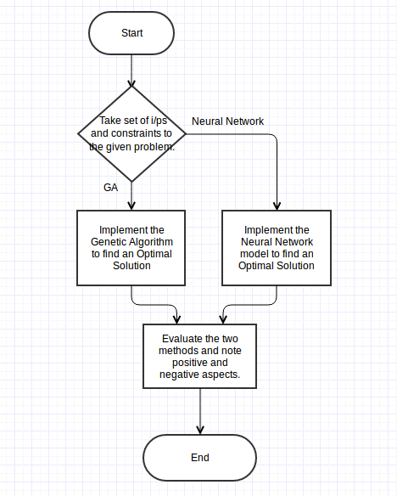
Project Methodolgy
The project is based on the simple idea of drawing a comparative study between Genetic Algorithms and Neural Networks.
Results from both are drawn and compared with each other to find an optimal solution.

Slide 19
Work Schedule
Schedule of the work done and distribution of work over the course of the past eight weeks

Slide 20
Justification / Work Schedule
Week 1 : Introduction to Git and GitHub
Week 2: Introduction to Python Basics
Week 3: Introduction to Advanced Python
Week 4: Introduction to Genetic Algorithms in Python and ‘Hello World’ in Python
Week 5: Watch Videos related to Genetic Algorithms and implement sample programs.

Slide 21
Justification / Work Schedule
Week 6: Exam Week - No work done
Week 7: Reading research papers including base papers and finding two reference papers for the same

Slide 22
References
References taken both online and offline to read on the topic

Slide 23
References
Solving the Academic Timetable Problem Thinking on Student Needs (2015 IEEE 14th International Conference on Machine Learning and Applications) - Base Paper
Solving Timetable Scheduling Problem by Using Genetic Algorithms - Reference Paper 1
Using a Genetic Algorithm Optimizer Tool To Solve University Timetable Scheduling Problem(Signal Processing and Its Applications, ISSPA 2007.) - Reference Paper 2

Slide 24
References
Nature Of Code
Tutorial Videos on Genetic Algorithms

Slide 25
Thank You!

